Slide 1
Basic Statistics
Gale Lucas
lucas@ict.usc.edu

Slide 2
Today’s Topics
Recap
Inferential statistics

Slide 3
Recap

Slide 4
Statistics
Descriptive statistics
Summarizes data
Inferential statistics
Inferences from the data
Tests of statistical significance

Slide 5
What are Standard Deviation (SD) and Mean (M)?
Measurement of variability
How variable or spread out is the data?
Measurement of central tendency
Mathematical midpoint (average) of a data set
What are the potential problems with this?
Mean – average
Median – middle
Mode - most

Slide 6
What is Standard Error and Sampling distribution?
Repeatedly taking random samples (of specific size, “N”), then make a distribution of their test statistic
Now have a set of means (can display in histogram), has same properties as we’ve been leveraging so far…
Measurement of variability OF SAMPLES
Is our sample so unusual that its unlikely to have come from this sampling distribution (.05 or 5% chance of error)?

Slide 7
Z-test vs t-test
For all (but the last) examples, we had access to μ and σ – that's unusual
Z test: Compare Z-scores
locate our sample score on a distribution by converting it to a Z-score (known properties)
technically also did for single scores
Usually have to estimate mu & sigma based on sample M & SD
T-test

Slide 8
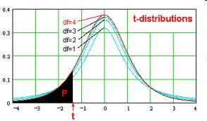
Distribution is not quite “normal”
Notes:
Becomes more like a z-distribution

Slide 9
Sampling distribution
Z and t are “test statistics,” each has its own sampling distribution
All test-statistics (Zs, Ts, Rs, Fs, Chi-squares, Bs) have their own sampling distribution
Same logic and overall process apply for those

Slide 10
Recap: Z-test vs t-test
When use a Z-test vs t-test?
Z test if you can calculate σ²_{M} from access to population σ²
Single sample t-test if you have to estimate σ²_{M} from sample standard deviation (special formula for sample variance)

Slide 11
Inferential Statistics

Slide 12
User study
Gather random sample from a population
Randomly assign to different conditions
Random assignment to conditions that only differ on (thus manipulate) one variable

Slide 13
User study
Population of users
From the raw data, it is impossible to tell if the groups differ!
If there is a difference, is it reliable?
Sample
A
B
4 5 6 1 3 6 2 7 7 3 2 7 4 6 7 2 5 5 2 3 7 5 7 3 7 6 7 2 3 7
6 1 7 4 2 5 3 1 2 2 2 4 1 1 3 4 2 5 6 1 4 6 5 1 2 7 7 2 7 2

Slide 14
User study
Gather random sample from a population
Randomly assign to different conditions
Random assignment to conditions that only differ on (thus manipulate) one variable
Compare!
Inferential statistics

Slide 15
Statistical Significance
Running a statistical test gives you a p-value
p (or p-value) is the probability that we are saying there is an effect when there is not (what are other ways of saying this?)
incorrectly rejecting the null, false positive, type I error
if p is less than designated cutoff, then we say the result is statistically significant
A professional way of saying “We found something!”

Slide 16
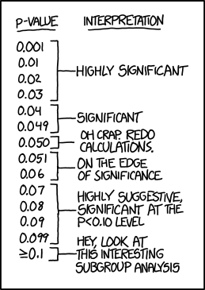
Cutoffs

Slide 17
Types of statistical tests
Both IV and DV can either be “categorical” or “continuous”
“groups” vs “how much?”
Think continuous, think “continuum”
___________________
1 2 3 4 5 6 7
Ask yourself: “can I put these in order?”

Slide 18
Types of statistical tests
 | Continuous IV (e.g., how much) | Categorical IV (e.g, exp vs control)
Continuous DV (e.g., how much)
Categorical DV (e.g., yes/no)

Slide 19
Types of statistical tests
 | Continuous IV (e.g., how much) | Categorical IV (e.g, exp vs control)
Continuous DV (e.g., how much) |  | t-test
Categorical DV (e.g., yes/no)

Slide 20
Types of statistical tests
 | Continuous IV (e.g., how much) | Categorical IV (e.g, exp vs control)
Continuous DV (e.g., how much) | correlation | t-test
Categorical DV (e.g., yes/no)

Slide 21
Types of statistical tests
 | Continuous IV (e.g., how much) | Categorical IV (e.g, exp vs control)
Continuous DV (e.g., how much) | correlation | t-test or ANOVA
Categorical DV (e.g., yes/no)

Slide 22
Types of statistical tests
 | Continuous IV (e.g., how much) | Categorical IV (e.g, exp vs control)
Continuous DV (e.g., how much) | correlation or regression | t-test or ANOVA
Categorical DV (e.g., yes/no)

Slide 23
Types of statistical tests
 | Continuous IV (e.g., how much) | Categorical IV (e.g, exp vs control)
Continuous DV (e.g., how much) | correlation or regression | t-test or ANOVA
Categorical DV (e.g., yes/no) |  | chi-square test

Slide 24
Types of statistical tests
 | Continuous IV (e.g., how much) | Categorical IV (e.g, exp vs control)
Continuous DV (e.g., how much) | correlation or regression | t-test or ANOVA
Categorical DV (e.g., yes/no) |  | chi-square test or loglinear

Slide 25
Types of statistical tests
 | Continuous IV (e.g., how much) | Categorical IV (e.g, exp vs control)
Continuous DV (e.g., how much) | correlation or regression | t-test or ANOVA
Categorical DV (e.g., yes/no) | logistical regression | chi-square test or loglinear

Slide 26
Types of statistical tests
 | Continuous IV (e.g., how much) | Categorical IV (e.g, exp vs control)
Continuous DV (e.g., how much) | correlation or regression | t-test or ANOVA
Categorical DV (e.g., yes/no) | logistical regression | chi-square test or loglinear

Slide 27
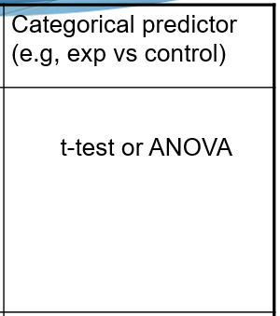
Types of statistical tests
We will now cover, in-depth:
1. independent samples t-test
2. paired samples t-test
3. one-way ANOVA
4. repeated measures ANOVA
5. factorial ANOVA

Slide 28
t-tests
Single sample t-test (RARE! and for a different kind of research question)
T-tests for conducting comparisons
Independent samples t-test vs. paired samples t-test

Slide 29
Paired-Samples t-test
Compares one group that has been tested twice
Before and after; under two different conditions
Participants reported higher levels of simulator sickness from before (M = 18.20, SD = 5.32) to after the virtual reality session (M = 29.17, SD = 4.97) , t(29) = 2.69, p = .01.

Slide 30
Paired-Samples t-test
Calculate difference scores
Subtract, so have one set of (difference) scores
You can create difference score from:
people who are “tied together” (kid & parent)
matched design (control & experimental)
before & after
within-subject design (control & experimental)

Slide 31
M = mean of difference scores
M_{diff} = Σ X_{diff} / N (# of pairs)
M_{diff} =(0+-5+-1+2)/4=-1
Pair #
Sample 1:
Kid
Sample 2:
Parent
Difference score
1
14
14
0
2
18
23
-5
3
15
16
-1
4
22
20
2

Slide 32
Example
Difference score
X_{diff} – M_{diff}
(X_{diff} – M_{diff})²
S² = 26 / 3
0
1
1
= 8.67
-5
-4
16
S²_{M} = 8.67 / 4
= 2.17
-1
0
0
S_{M} = √2.17
2
3
9
= 1.47

Slide 33
Example
t = M_{diff} - µ_{M}
S_{M}
t = -1 - 0
1.47
= -.68

Slide 34
Independent Samples t-test
Compares two independent groups
Math SAT scores were higher for students admitted to the Computer Science program (M = 704.45, SD = 50.94) than those admitted to Psychology (M = 564.17, SD = 45.92) , t(158) = 12.94, p < .001.

Slide 35
t-tests
Participants in the experimental condition (M = 114.32, SD = 3.97) had higher scores than participants in the control condition (M = 80.25, SD = 4.03), t(18) = 19.05, p = .0001.
Reporting the result of a t-test
degrees of freedom
(N – 1)
t-value
significance

Slide 36
Analysis of Variance (ANOVA)
Used when experiment has a more complex design (variables with more than two levels, multiple predictor variables)
One-way ANOVA
Repeated measures ANOVA
Factorial ANOVA

Slide 37
One-way ANOVA
Used when the predictor variable has more than two levels
Example: A study examining the GPAs of undergraduate, master’s, and Ph.D. students. (3-levels)

Slide 38
Repeated measures ANOVA
Used when group has been tested more than twice
Example: Participants’ responses are tested before, during, and after (3-levels)

Slide 39
Factorial ANOVA
Used for multiple predictor variables
One or more can be repeated measures
Each variable has a main effect
Variables can have interaction effects

Slide 40
Interaction Example
Experiment looked at the effects of both task difficulty and gender on verbal ability.
Main effect for difficulty is not significant.
Main effect for gender is not significant.
Interaction effect is significant!

Slide 41
Interaction Example
Difficulty main effect
Gender main effect
Simple Difficult
Male Female
Interaction effect
Female
Male
Simple Difficult
Does the effect of one predictor variable on the outcome variable depend on the other predictor variable?
If so, there is an interaction between the variables

Slide 42
Types of statistical tests
Which of these are most similar to each other?
1. independent samples t-test
2. paired samples t-test
3. one-way ANOVA
4. repeated measures ANOVA
5. factorial ANOVA

Slide 43
Types of statistical tests
 | Continuous IV (e.g., how much) | Categorical IV (e.g, exp vs control)
Continuous DV (e.g., how much) | correlation or regression | t-test or ANOVA
Categorical DV (e.g., yes/no) | logistical regression | chi-square test or loglinear
independent samples t-test
paired samples t-test
one-way ANOVA
repeated measures ANOVA
factorial ANOVA

Slide 44
Types of statistical tests
 | Continuous IV (e.g., how much) | Categorical IV (e.g, exp vs control)
Continuous DV (e.g., how much) | correlation or regression | t-test or ANOVA
Categorical DV (e.g., yes/no) | logistical regression | chi-square test or loglinear
independent samples t-test
paired samples t-test
one-way ANOVA
repeated measures ANOVA
factorial ANOVA

Slide 45
Chi-Square
Used to analyze categorical (count or proportion) data
There were significantly more women in the psychology program (183 of 206) than the computer science program (23 of 145), χ² (1, N = 351) = 16.32, p < .01.
sample
χ² value
significance

Slide 46
Correlation coefficient
Used to represent the relationship between two continuous variables
There was a significant relationship between yearly salary and IQ, r (N = 112) = .60, p = .01.
sample
r
significance

Slide 47
Correlation Coefficient -- r
Indicates strength
of relationship
(0.00 to 1.00)
Correlation
coefficient
r =
+
r = +0.50
0.63
Indicates direction
of relationship
(positive or negative)

Slide 48
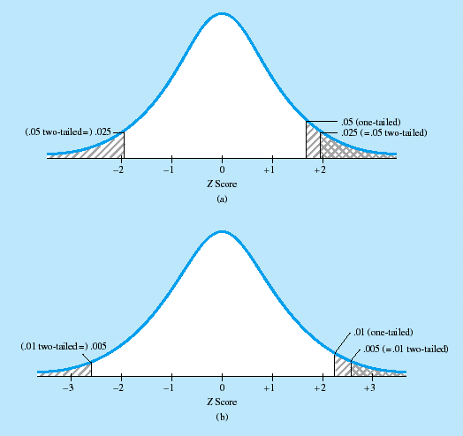
Final note: Two-tailed NHST
We’ve shown two-tailed NHST, the most accepted version
Possible to do one-tailed (put all values in one basket)
What are problems with this?
2.5%
2.5%
5%
Notes:
48

Slide 49
Final note: Assumptions (of these tests we’ve been talking about)
Normality: Sampled population is normally distributed
Homogeneity: Equal variances across groups
Solutions if these are violated
Transform the data
With large enough N, some accept these as robust against violations
Statistical programs will sometimes give output as if groups weren’t equivalent
Alternative tests

Slide 50
Today’s Topics
Recap
Inferential statistics

